Slide 1
Capstone Project
Sporting Events System (SES)
Primary Module : Ticket module
www.collaberadigital.com

Slide 2
Profile Details
Past Experience : 5 years of full-stack development experience, specializing in mobile app development, Payment Gateways, API integration, and Inventory systems across Finance, Education, and Banking fields.
Qualification : Bachelor of Science in Information Technology
Career Summary :
Full Stack Development : June 2018 – Present
Technology Stack :
UI technologies : React Native, Html, CSS, Bubble
Back-end technologies : Java, SpringBoot, Firebase, Bubble, Express
Database : MySQL, MongoDB

Slide 3
Sporting Events System Capstone Project
Primary Module : Ticket module
The implemented module allows the system administrator to manage different sporting events like the Volleyball or Basketball World Cup, Or Tournaments that includes non team competion.
stores information ticket including Teams, Players, and other.
Microservices Structure seamless communication to other modules.
All modules are separate and have their own microservices
Scalable and flexible

Slide 4
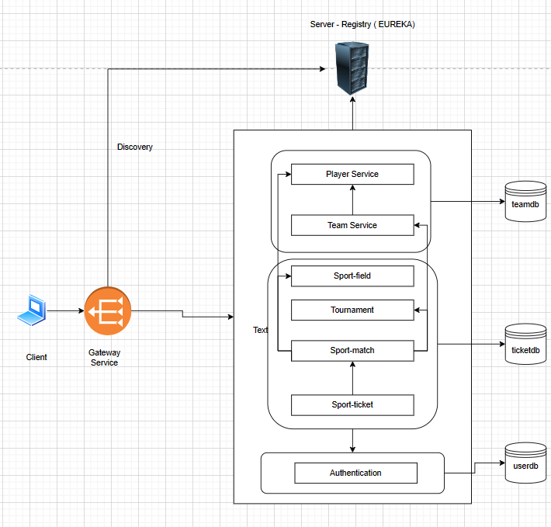
Application Architecture

Slide 5
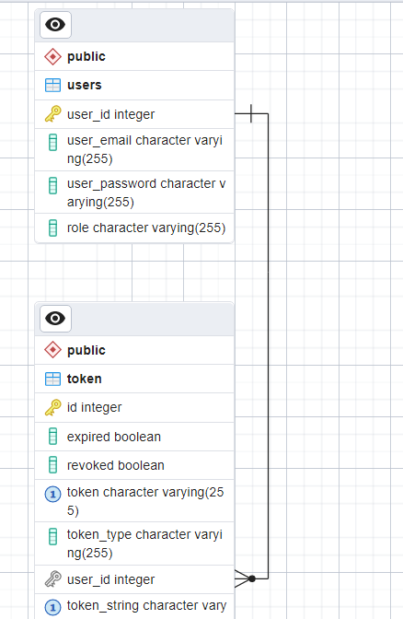
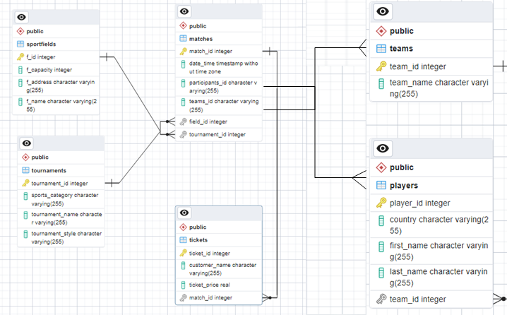
Database Design

Slide 6
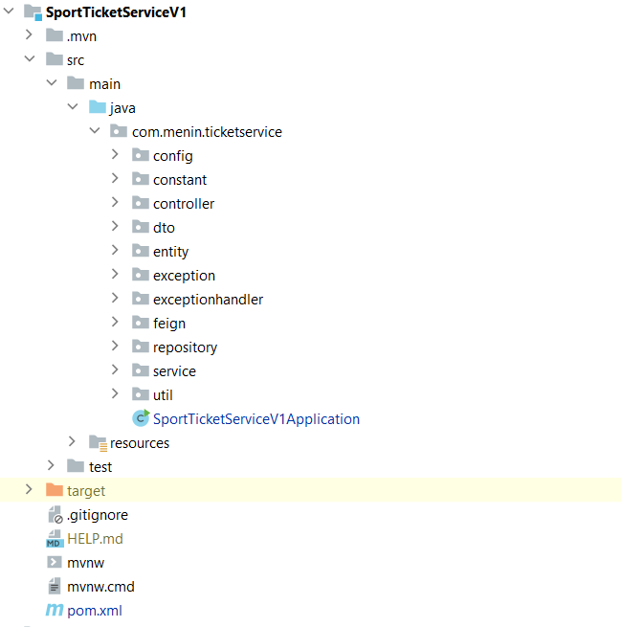
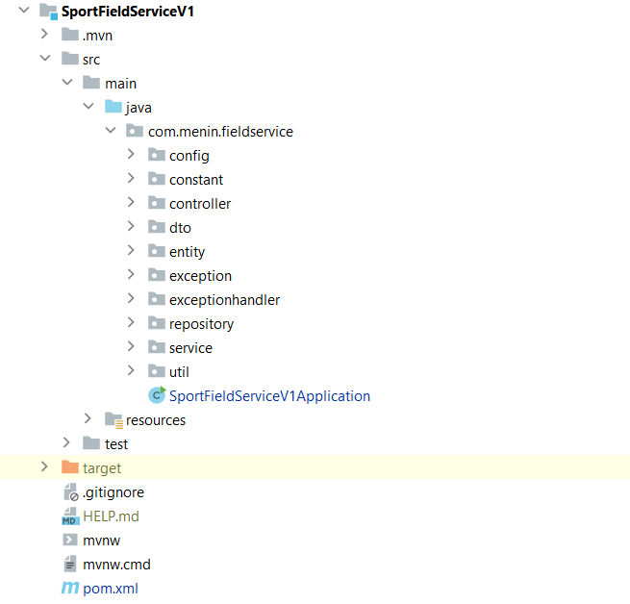
PROJECT STRUCTURE

Slide 7
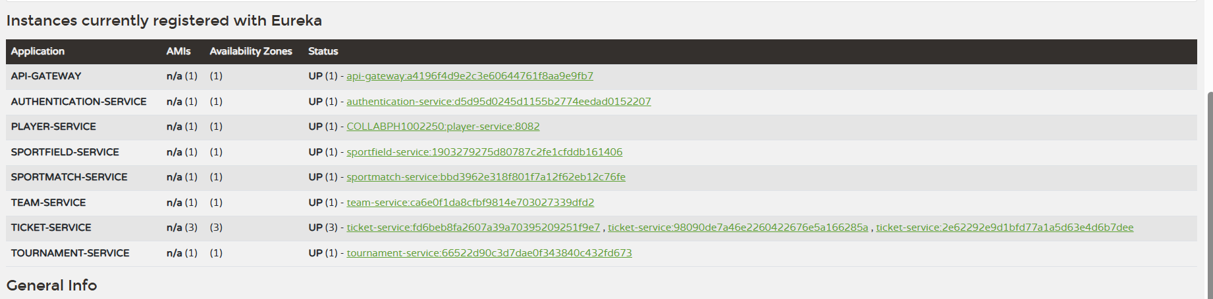
EUREKA SERVER
Eureka Registry

Slide 8
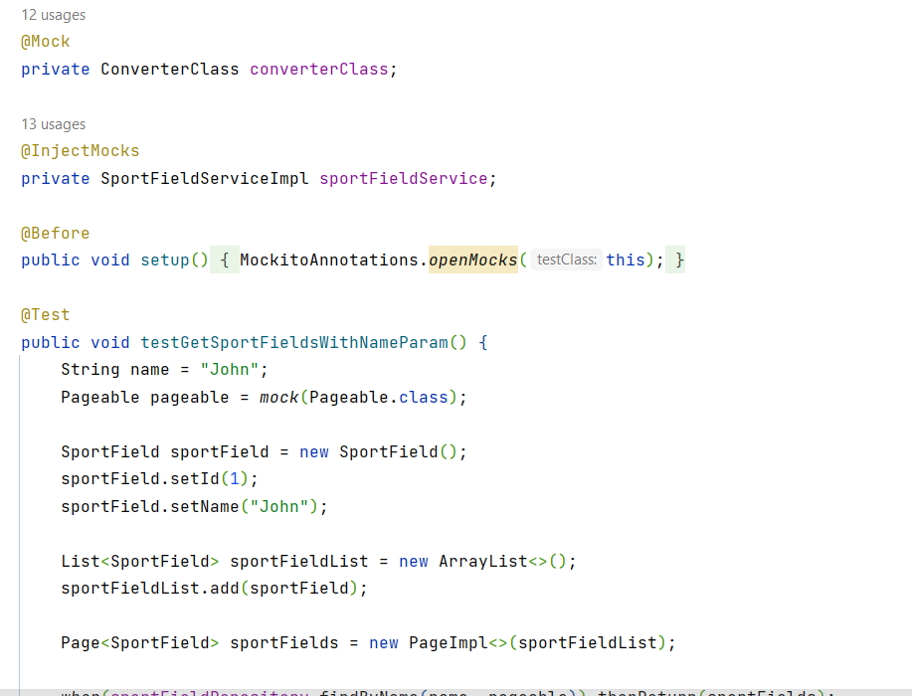
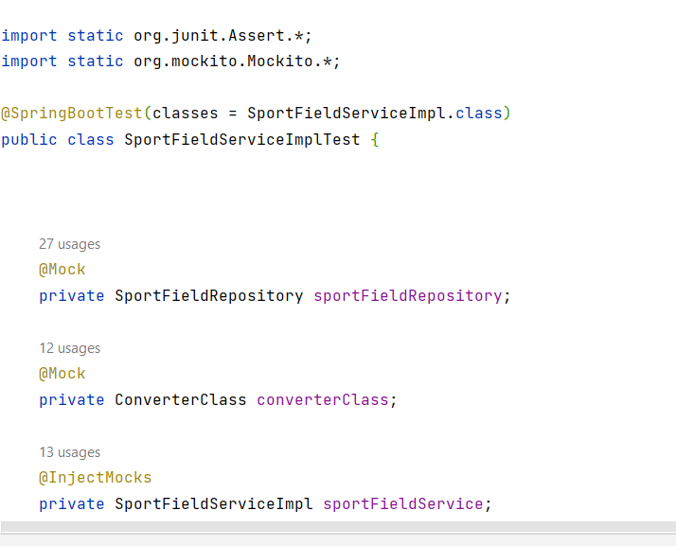
UNIT TESTING

Slide 9
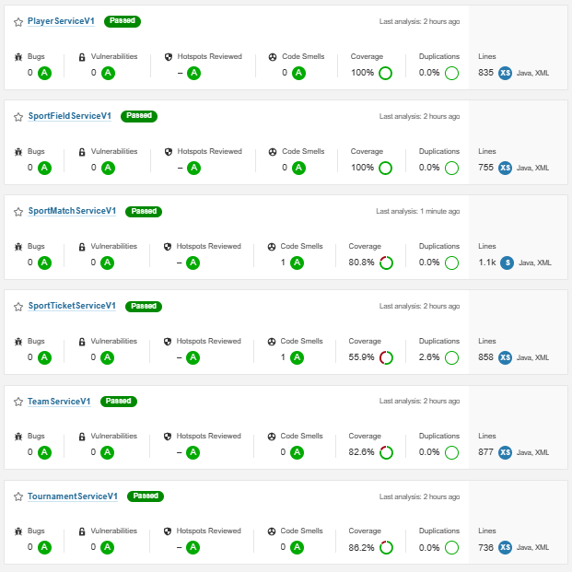
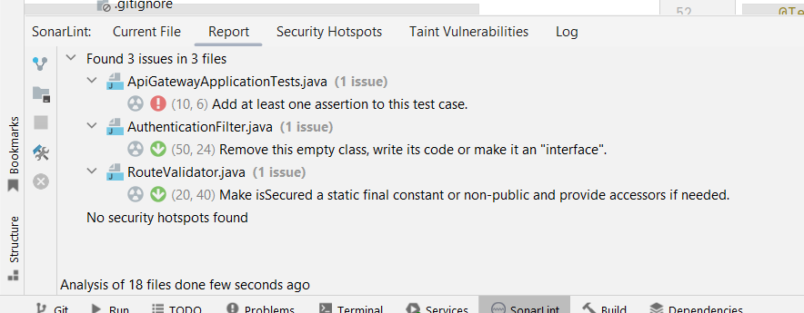
SONARQUBE Analysis

Slide 10
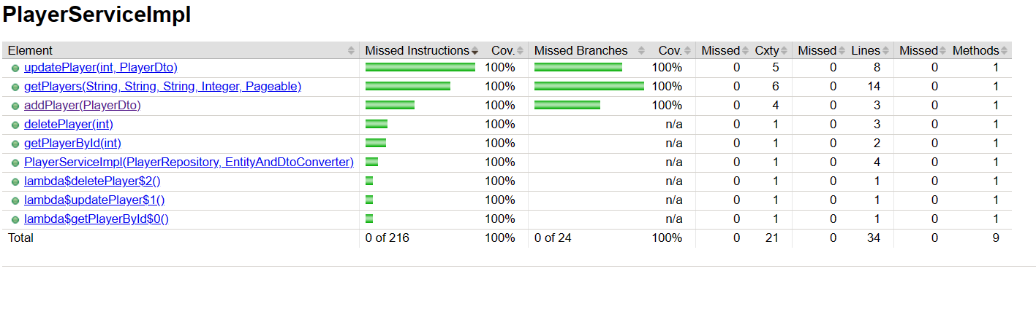
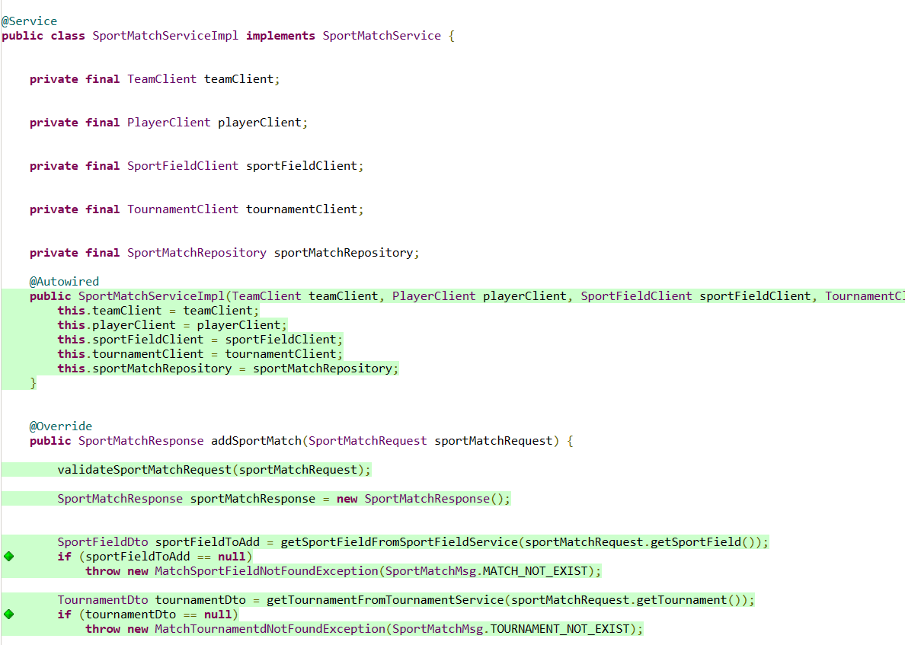
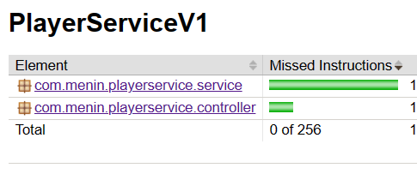
Coverage report With Jacoco

Slide 11
Client Features

Slide 12
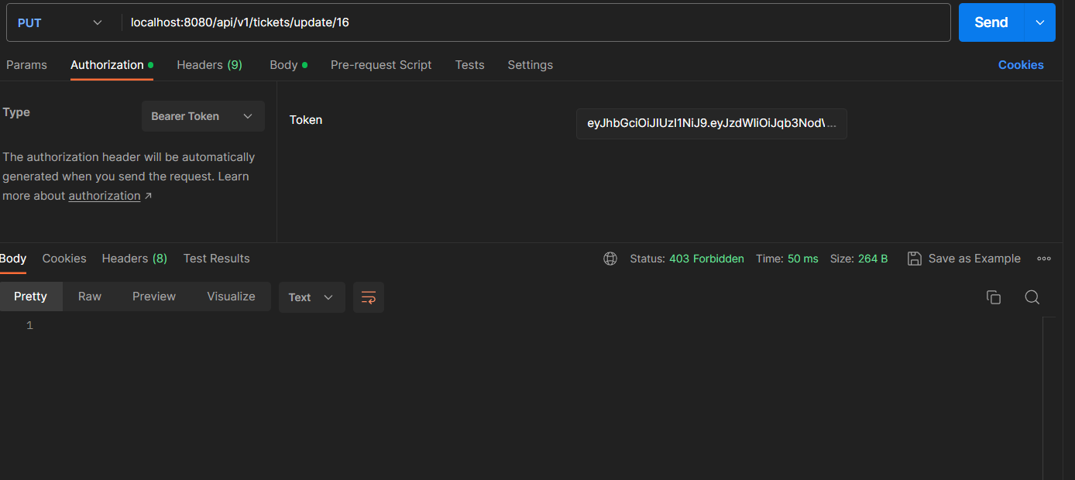
Secured Application

Slide 13
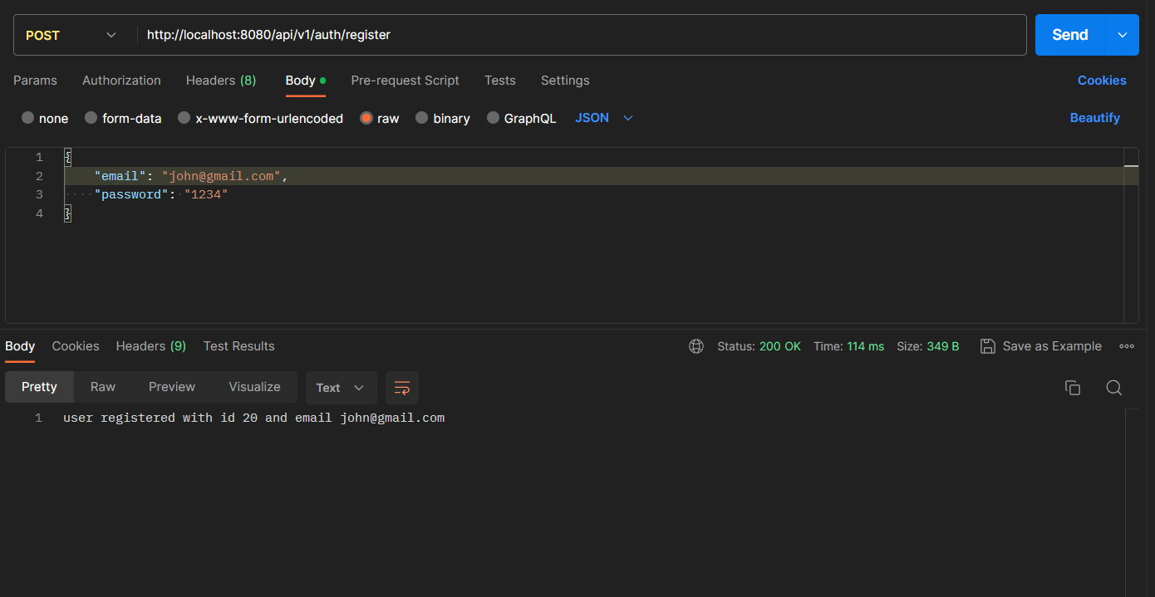
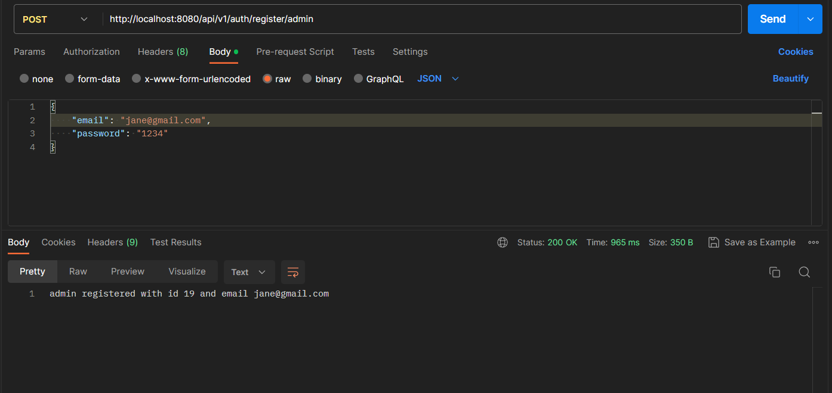
ADMIN and USER registration

Slide 14
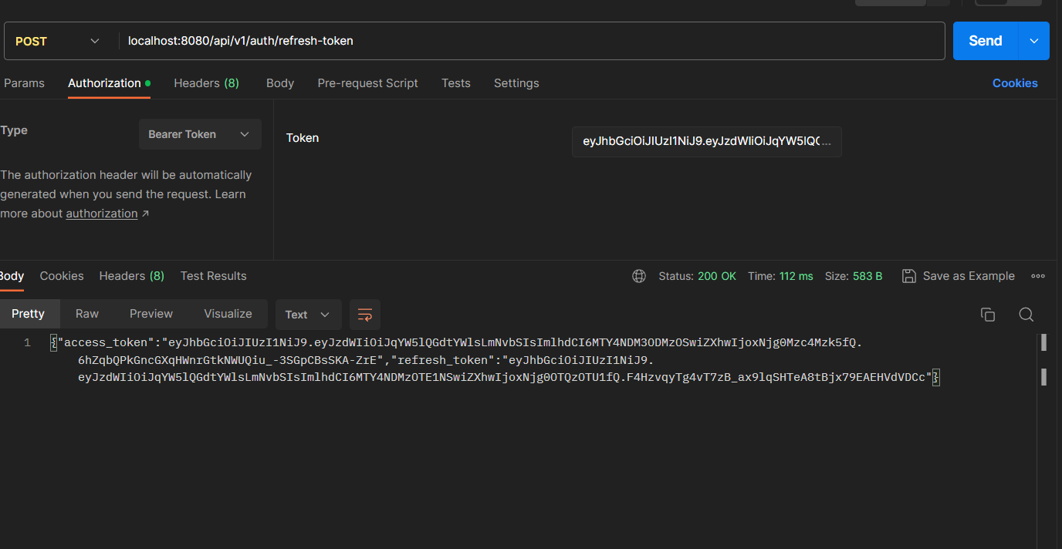
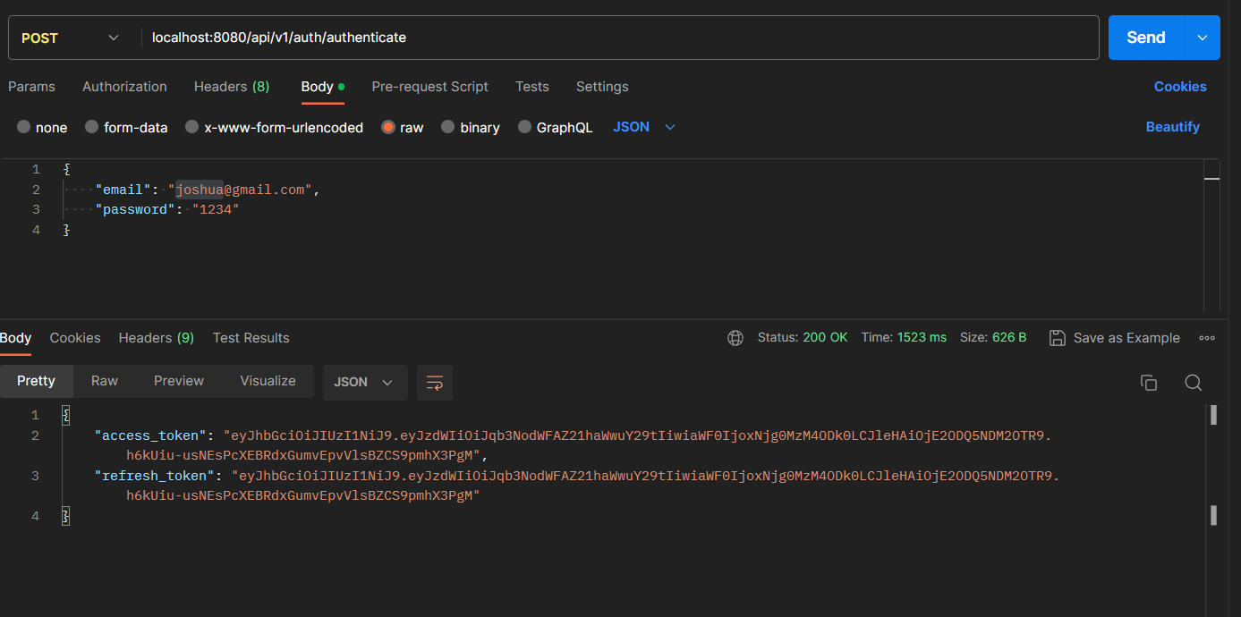
Authentication and Refresh Token
Authentication and Refresh Token

Slide 15
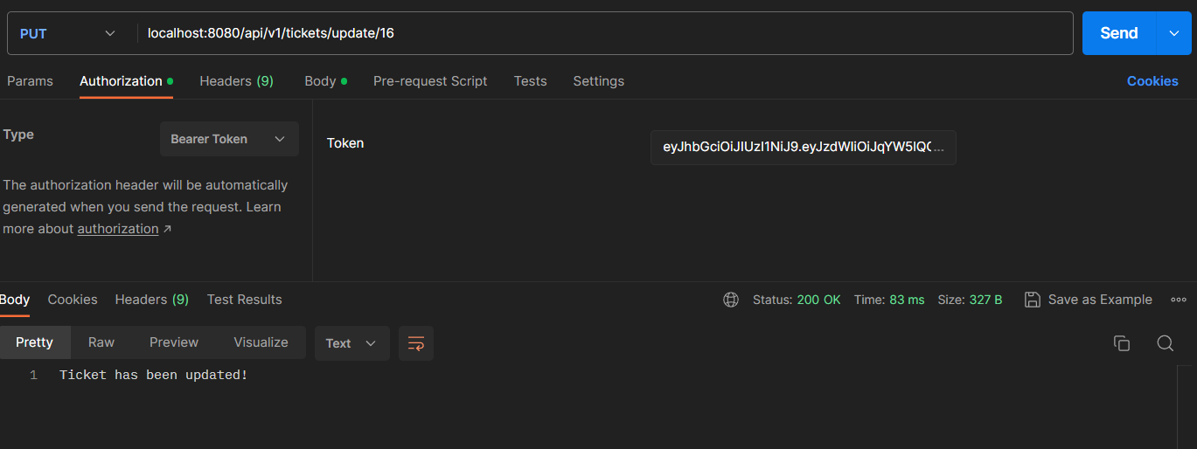
ADMIN/USER specified secured endpoints (Role based access)
ADMIN/USER specified secured endpoints

Slide 16
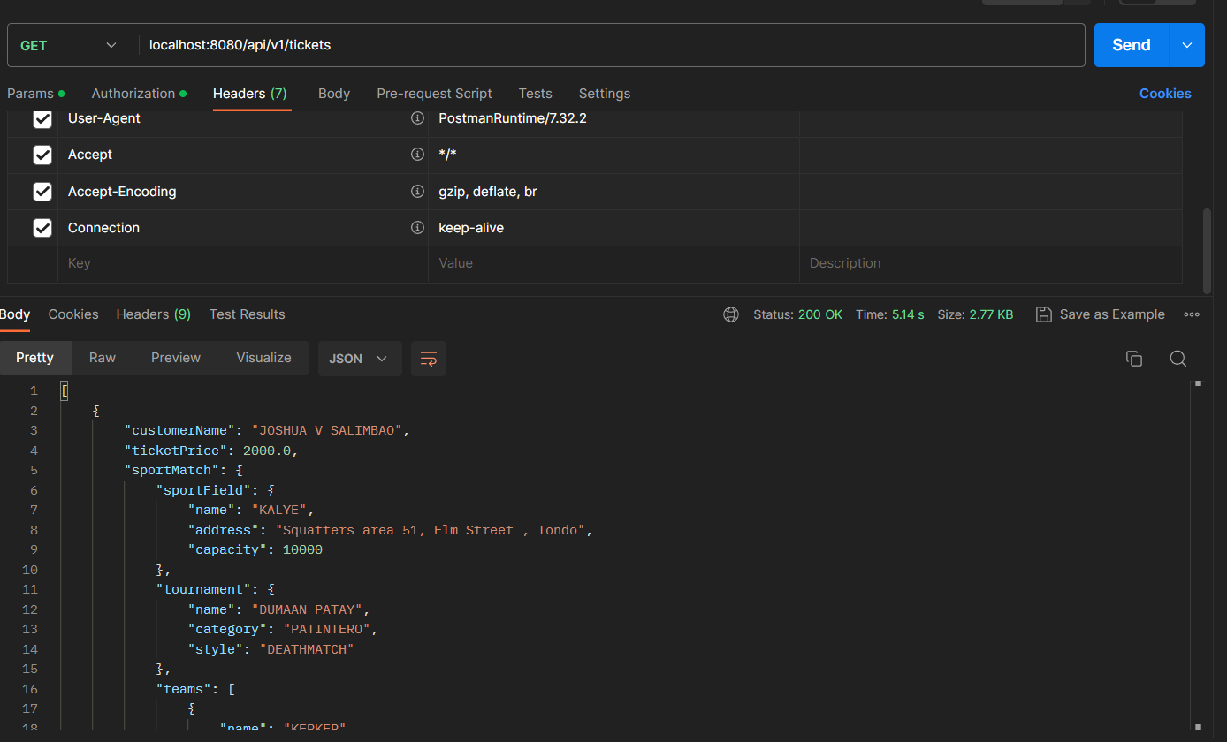
CRUD

Slide 17


Practical Hands-on Learning Approach
Designed relational database
Conducted unit tests
Improved code quality
Reviewed code with trainer
Refactored based on feedback
Explored problem-solving techniques
Presented in-class
Participated in weekly quizzes
Successfully completed mid-term test.
www.collaberadigital.com

Slide 18
Key Takeaways/Learnings from the Program (HTD)
Microservices: Spring Boot, Spring Cloud
Testing: Unit testing, code coverage
Code Quality: Clean code, SonarLint, SonarQube
Database: JDBC, Hibernate ORM
API Testing: Postman
Cloud: Eureka Server, API Gateway, FeignClient
Security: Spring Security, JWT Token
Dependency Management: Maven
Teamwork

Slide 19
Conclusion
I am now confident in building enterprise applications using microservices, thanks to a practical learning approach focused on real-time project practices.
Eureka server registers multiple instances of different microservices
High availability achieved with multiple instances and client-side load balancing
Relational database used for ensuring data isolation and flexibility
FeignClient used for inter-microservice communication
API gateway handles requests to various endpoints
Codebase monitored by SonarQube to Assure good quality
Over 80% code coverage in Service and Controller classes with JUnit testing and Mockito

Slide 20
Thank You
www.collaberadigital.com

